Slide 1

Research methods in Psychology

Slide 2
Contents
What is research
Why conduct research
Main concepts: Theory, Induction, Deduction, Hypothesis, Operational definition.
Research methods
Naturalistic observation
Experimental method
Survey and interview
Case study and focus group
Meta-analysis

Slide 3
What is research? Creative and systematic work undertaken to increase the stock of knowledge

Slide 4
Psychology as a Science
What is science about?
Facts (Islamabad is the capital of Pakistan, Heart pumps blood throughout the body, we need oxygen to survive)
Proof (written in constitution, circulatory system and respiratory system)
Research
That’s what Psychology attempts to do as well, which is why we call it a science.

Slide 5
Research in Psychology
Research helps us in finding answers that are supported by factual evidence (could be proven, repeated or observed), instead of just relying on opinion, intuition, what people say, and luck
Objective understanding of ourselves and our world
History has many examples of how our “common sense” or intuition failed us
Mental illness and possession
Earth being square

Slide 6
Using Research Information
As a consumer
As a researcher
As a student
As policy makers

Slide 7
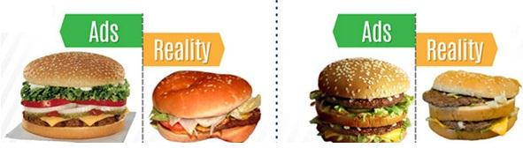

Slide 8
Bottom line
Research is what makes the difference between facts and opinions.
Facts: Observable realities
Opinion: personal judgements, attitudes, or conclusions that may or may not be accurate.

Slide 9
Scientific Method
Question / Theory
Hypothesis
Test Hypothesis
Draw Conclusions
Report Results

Slide 10
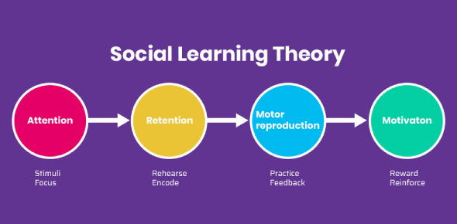
Important terms in the scientific methodology.
Theory:
A structured set of principles intended to explain a set of phenomena. A theory provides a coherent structure (logical and sensible structure) for relating various observations and often permits predictions of future observations.
A plausible or scientifically acceptable general principle or body of principles offered to explain phenomena.
Examples:
Social Learning Theory: we learn by observing others.

Slide 11
Attentional phase is the first stage in the observational learning process. During this phase a person pays attention to a role model who is attractive, successful, interesting, and/or popular (a child witnesses his father getting angry every time he want others to listen/obey him/ want others attention).
Retention phase is about retaining the learned information in memory.
Once person’s attention is captured, it is time to demonstrate behavior that the model wants the person to imitate and then give the person a chance to practice this behavior. During reproduction, the person tries to match his/her behavior with model’s (the child copies his father every time he wants his parents attention).
Motivational phase is the finale stage when the person imitates behavior of the model because he/she believes that doing so will increase his/her own chances to be reinforced (parents give attention positive reinforcement strengthening of behavior / parents scold punishment extinction of behavior)

Slide 12
Induction: a process of reasoning based on forming general principles from specific observations. E.g. Isaac Newton and the falling apple → gravity. (specific to general)
Induction is used to form hypothesis and theories.
Examples:
Statement: Every dog I meet is friendly.
Hypothesis: Most dogs are usually friendly.
Statement: I tend to catch colds when people around me are sick.
Hypothesis: Colds are infectious
After analyzing high-performing and successful employees in the marketing department, a recruiter recognizes they all graduated with a degree in business, marketing or journalism. She decides to focus on future recruiting efforts on candidates with a degree in one of those three disciplines.
A salesperson notices when they share testimonials from current and past clients with their prospects, they’re 75 percent more likely to make a sale. Now they share testimonials with all prospects to improve their close rate.
After noticing assisted living center residents’ moods improve when young children visit, an activities leader develops a volunteer initiative with local schools to pair students with center residents.

Slide 13
Deduction: the process of drawing specific conclusions from a set of general principles. E.g. Freud believed that aggression is an innate drive → aggressive behavior. Thus deduction: if someone commits a murder it is due to this innate drive. (general to specific)
If A= B and B=C, then A must be equal to C
For example,
A=B: All spiders have eight legs.
B=C: A tarantula is a spider.
A=C: Therefore, tarantulas have eight legs."
A=B: All mammals have backbones.
B=C: Humans are mammals.
A=C: Humans have backbones.
A=B: All birds lay eggs.
B=C: Pigeons are birds.
A=C: Pigeons lay eggs.
A=B: All plants perform photosynthesis.
B=C: A cactus is a plant.
A=C: A cactus performs photosynthesis.

Slide 14
Hypothesis: a statement describing a proposed relationship between different types of variables.
Examples:
Daily exposure to the sun leads to increased levels of happiness.
If a first-year student starts attending more lectures, then their exam scores will improve.
Students who eat breakfast will perform better on a math exam than students who do not eat breakfast.
People with high-sugar diets and sedentary activity levels are more likely to develop depression."
Younger people who are regularly exposed to green, outdoor areas have better subjective well-being than older adults who have limited exposure to green spaces.
Variables : Behaviors, events, or other characteristics which can change or vary in some way.

Slide 15
Here's a framework to write a hypothesis:
1. Identify the Variables: Clearly identify the variables involved in your study. There should be at least one independent variable (the factor you are changing or manipulating) and one dependent variable (the outcome you are measuring).
2. State the Relationship: In a clear and concise statement, express the expected relationship between the variables. This can be a prediction of how changes in the independent variable(s) will affect the dependent variable(s). Or a relationship between variable.
3. Make it Testable: Ensure that your hypothesis is testable and can be empirically investigated through data collection and analysis.
4. Be Specific: Avoid vague or ambiguous language. Your hypothesis should be specific enough to guide your research.
5. Keep it Falsifiable: A hypothesis should be framed in a way that it can be proven false through evidence. If it cannot be falsified, it may not be a valid hypothesis.

Slide 16
Operational definition
Operational definition: a term whose meaning is derived from the processes or observable events used to measure it.
E.g. defining “beauty”.
To define beauty as ‘whatever is pleasing to the senses’ is not acceptable as an operational definition because it is not based on an observable event. However, defining it as ‘giving a dozen roses to someone’ is operational.
The difficulty with abstract concepts as given in this example is that sometimes the operational definition may be unrelated to the concept which it is supposed to define.

Slide 17
Research methods

Slide 18
Psychological Research
Methods of data collection:
Qualitative
Gathers information that is not in numerical form. For example, diary accounts, open-ended questionnaires, unstructured interviews and unstructured observations.
Data is typically descriptive data and as such is harder to analyze than quantitative data.
Includes focus groups, in-depth interviews, and reviews of documents for types of themes
Quantitative
Gathers data in numerical form which can be put into categories, or in rank order, or measured in units of measurement; used to construct graphs and tables of raw data.
Surveys, structured interviews & observations, and reviews of records or documents for numeric information

Slide 19
Difference
Qualitative
Primarily inductive process used to formulate theory or hypotheses
More subjective. More in-depth information on a few cases
Text-based , no statistical tests
Unstructured or semi-structured response options
Can be valid and reliable: largely depends on skill and rigor of the researcher
Time expenditure lighter on the planning end and heavier during the analysis phase
Less generalizable
Quantitative
Primarily deductive process used to test pre-specified concepts/hypotheses that make up a theory
More objective: provides observed effects (interpreted by researchers) on a problem or condition
Number-based, statistical tests are used.
Fixed response options
Can be valid and reliable: largely depends on the measurement /instrument used
Time expenditure heavier on the planning phase and lighter on the analysis phase
More generalizable

Slide 20
Types of Methods of Psychological Research
A research method is a procedure for examining a problem and gathering observations. These include:
Experimental Method: in this the researcher varies different factors to see what effect they have on each other.
Non-experimental Method / descriptive / correlation designs: in this the researcher can not have or do not attempt to have any direct control over aspects of behavior. For e.g. Testing coordination before and after alcohol or drug usage will not involve control over the quantity consumed.
A. Naturalistic Observation
B. Case Studies
C. Surveys

Slide 21
Experimental method
Independent variable IV: Condition or event manipulated by experimenter
Dependent variable DV: aspect of behaviour thought to be affected by independent variable or the variable being tested and measured in an experiment
Experimental group: Participants who receive special treatment
Control group: Similar subjects who do not receive treatment given to experimental group
Extraneous variables: factors besides IV that might affect DV, hence they need to be controlled

Slide 22
Cause and effect
The only way to make cause and effect statements is to conduct an experiment to answer a research question.
Other research methods (non-experimental) cannot give you cause-and-effect.

Slide 23
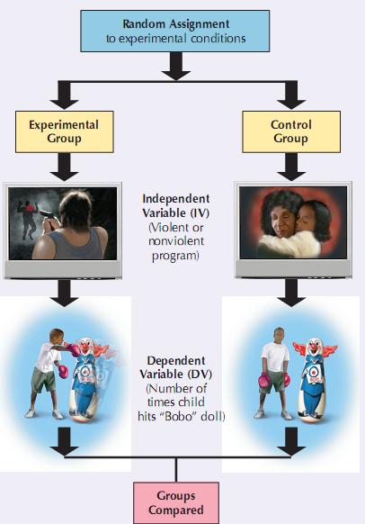
Does TV increase aggression? Only an experiment can determine cause & effect.

Slide 24
Random samples and Random assignment
Why is it important to have a random sample
Why is it important to randomly assign to experimental and control groups?
Random sampling refers to how you select individuals from the population to participate in your study.
Random assignment refers to how you place those participants into groups (such as experimental vs. control)

Slide 25
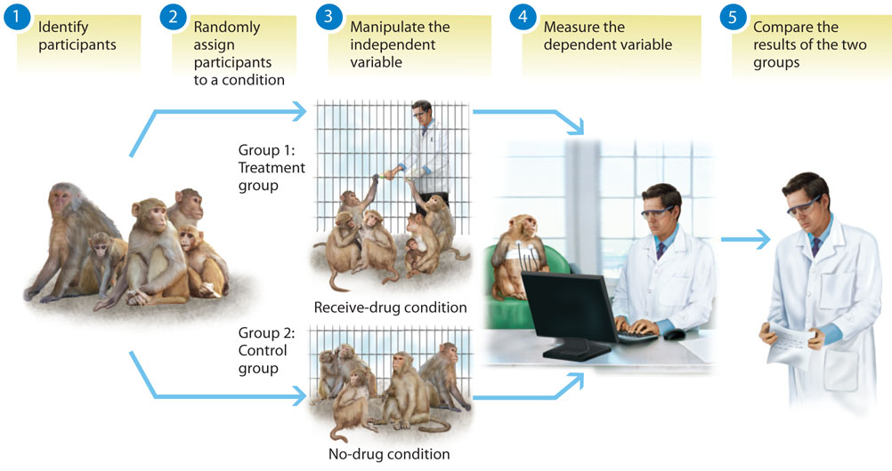
Experiment Example

Slide 26
Research Methods—Experimental (Continued)
Potential participant problems:
Sample bias: research participants are unrepresentative of the larger population
Example: usage of drugs by teenagers (sample = college students)
Participant bias: research participants are influenced by the researcher or experimental conditions
Example: social desirability, the halo effect etc

Slide 27
Research Methods—Experimental (Continued)
Potential researcher problems:
Experimenter bias (researcher influences the research results in the expected direction)
Ethnocentrism (believing one's culture is typical of all cultures)

Slide 28
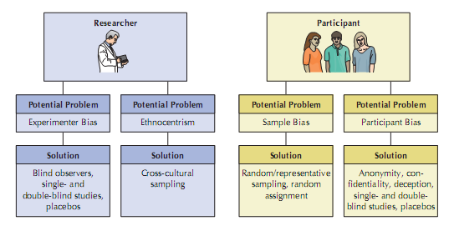
Research Methods—Experimental (Continued)

Slide 29
Reliability and Validity
Reliability: the ability to give stable and consistent results. Reliable, dependable (aka will give consistent results or measurements every time).
Validity: the ability to accurately measure/test what it’s supposed to measure/test.

Slide 30
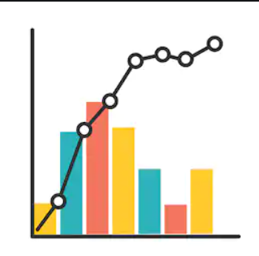
Correlational Research
Correlation: a relationship between two or more variables
When two variables are correlated, it means that as one variable changes, so does the other.
It doesn’t necessarily imply cause and effect between the variables.
Correlation is not causation
It does not tell you about cause and effect

Slide 31
More ice-cream = more crime?
Research shows that as sales in ice-cream increase, so does the overall rate of crime
Does that mean people who have more ice-cream could possibly commit crimes?
Or, maybe it means people are so stressed by the rise in crime that they end up having more ice-cream?
Or, criminals decide to treat themselves to ice-cream after a job well done?
A relationship between the two does exist, but clearly one does not cause the other. There could be another variable (confounding or extraneous variable) involved.
Therefore…..

Slide 32

Does a correlation imply causation?

Slide 33
Correlational Research
Positive correlation
Negative correlation
No correlation
The stronger the correlation between two variables (aka the stronger the relationship between two variables), the more predictable changes in one variable will be as the other variable changes.

Slide 34
Measuring correlation
Correlation coefficient is a number from -1 to +1 that indicates the strength and direction of the relationship between two variables.
Direction:
Anything below 0 (minus): negative correlation
Anything above 0 (positive number): positive correlation

Slide 35
Correlation Review
Positive Correlation | Negative Correlation
Definition Indicates that as the value of one variable increases, we can predict that the value of the other variable will also increase | Definition Negative correlation tells us that as the value of one variable increases, the value of the other decreases.
Example The more time students spend studying for a test, the higher their grades on the test will be The less they study, the lower their test scores will be | Example As the number of hours spent studying increases, the number of hours spent partying decreases
Correlation Coefficient Correlation indicated by a positive number ranging between 0 and +1.0 | Correlation Coefficient Correlation indicated by a negative number ranging between 0 and -1.0

Slide 36
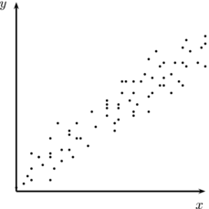
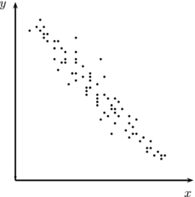
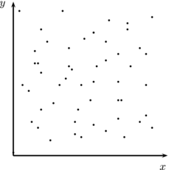
Correlations – Visually
Scatterplots give us visual representations of correlations.
The stronger the correlation, the closer the data points are on a straight line.
Positive correlation
Negative correlation
No correlation

Slide 37
Correlations
Extraneous/Confounding variable: outside factor or variable (often unanticipated) that causes the change
i.e the “third” factor or variable that’s responsible for the change, or that could be the reason for the change
Eg in the icecream/crime example, the weather was the extraneous variable (aka the weather is actually responsible for both higher icecream sales and more crime)

Slide 38

Observational Research
Naturalistic observation: careful systematic observation but no intervention with subjects.
Which of the following are observable behaviours?
Writing a letter
Feeling angry
Saying ‘please pass the salt’
Passing the salt
Perceiving a round object
Experiencing hunger
Walking rapidly

Slide 39
Food for thought!
Case:
Samantha, a three years old girl accidently breaks her mother’s vase while she is not present in the house. Later the mother sees the damage and says to Samantha, ‘ I see you’ve broken something’. Samantha’s reply is a classic example of psychology’s theme in direct observation. She says, ‘How do you know? Did you see me do it?’

Slide 40
Direct Observation
Any observational technique which depends on direct observation of behavior by the researcher rather than asking individuals to report their behavior.
A. Naturalistic observation: For eg. Observing children in playground settings / Candid Camera.
B. Participant observation: in this method, the researcher becomes part of the group he wishes to study
Advantage:
We get the first hand knowledge of what people do in their natural situations.
Disadvantages:
Furthermore, if people realize that they are being observed, they may change their natural response.
Lack of control is the biggest drawback.
Researcher is passive & simply records whatever is happening

Slide 41
Case Study
An in-depth intensive investigation of an individual or small group of people.
Case study often involve psychological testing – a procedure in which carefully designed set of questions is used to gain insight into the personality of the individual or group being studied.
It is used not only to gain insight about the individual but to understand the general behavioral patterns of people

Slide 42
Survey
Definition: a survey is a technique for determining attitudes of many individuals by providing a preplanned series of questions to which individuals respond.
Usage: Today, surveys are used extensively by government, political parties, corporations, the news media etc.
Types:
A. Close ended/Fixed alternative surveys:
i. “Yes’ , “No”, “I’m not sure”.
ii “Not at all”, “Sometimes”, “Often”, “Most of the time.” Likert Scale
ii Rating Scales. 1..2…3…4……….10.
B. Open ended surveys: these use interviewers guiding the respondent through several questions.

Slide 43
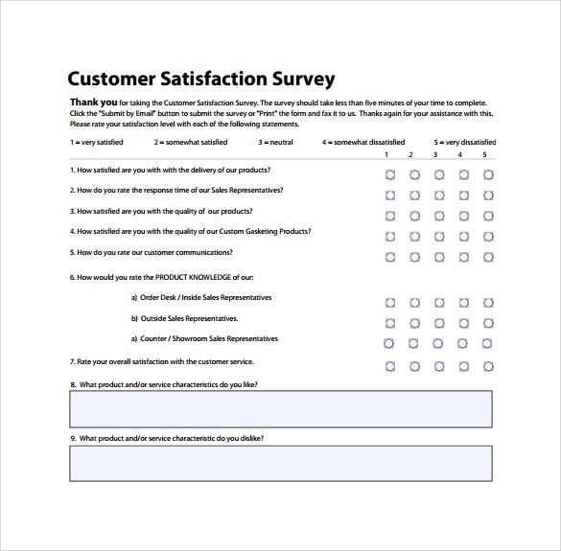

Slide 44
Advantages:
Straightforward way of finding out what people think, do, feel by asking them directly.
Survey methods have become highly sophisticated enabling us to make inferences.
Quick, easy, cost efficient
Disadvantages:
People may not give their true responses.
Accuracy of sample is also very important factor.

Slide 45
Interviews
Typically involves a face-to-face meeting in which a researcher (interviewer) asks an individual a series of questions.
Allows the interviewer to observe verbal & non-verbal behavior
Allows follow-up questions and clarifications
Advantage:
Allows for a wider range of responses
Disadvantage:
Time consuming
No cause-and-effect relationships can be inferred

Slide 46
Focus Groups
Focus Group Interviews
A group of people who discuss a subject under direction of a moderator.
Mostly done by marketers and sociologists to learn about the consumer insights and serious social issues.

Slide 47
Examples:
A political party may be interested in how young adult voters would react to certain policies.
By observing young adults discussing those policies, market researchers would then report their findings to their client. The client could be a political party, a newspaper, or a think-tank.
You are about to launch a new video game console, your target audience will be children and young adults.
A focus group of teenagers and young adults would discuss what is important for them. They would also discuss themes that you present to them.
You might be interested in their budgets, i.e., how much they are willing to spend. You would also like to know what console they currently have, whether they like it, and why they chose it.

Slide 48
Meta Analysis/Archival Research
Research in which existing data such as census documents, college records or newspaper clippings, previous studies are examined to test a hypothesis.
Advantages:
It is an inexpensive means of testing a hypothesis.
Faster way
Disadvantages:
The data may not be in the form which can be used to test the hypothesis fully.
The information could be incomplete or haphazard.

Slide 49
Rates and risk of postpartum depression—a meta-analysis
Causes of still birth since 2010

Slide 50
Separating Fact from Fiction
Be skeptical/doubtful!
Consider the source of information
Ask yourself, “Was there a control group?”
Look for errors in distinguishing between correlation and causation (are claims based on correlational results yet passed off as causations?)

Slide 51
Separating Fact from Fiction (cont)
Be sure to distinguish between observation and inference (e.g., Robert is crying, but do we know why he is crying?)
Beware of oversimplifications, especially those motivated by monetary gain
For example is not proof!

Slide 52
The Barnum Effect
Barnum effect: Tendency to consider personal descriptions accurate if stated in general terms
Always have a little something for everyone. Make sure all palm readings, horoscopes, etc. are so general that something in them will always apply to any one person!

Slide 53
The Ethics of Research
Protection from harm - no Coercion: must be voluntary participation. Should not affect them in any way during or after the study
Informed consent should be documented
Participants must be informed of nature and procedures of research
Assurance that participation is voluntary
Risks and limits on confidentiality must be explained. Confidentiality = anonymity = privacy
Deception involving participants must be justified
Debriefing refers to explaining the research process to the participants at the end of the study.
Ethical guidelines are in place to protect participants

Slide 54

Your Research Project

Slide 55
Steps in Conducting Research
What do you want to study? (identifying your research problem)
Literature review (what information already exists)
Specifying the purpose of research (What will be the outcome of my research?)
Hypothesis
Collect data
Analyzing and interpreting the data
Reporting and communicating research findings and recommendations (for future research and replication)

Slide 56
Questions?
Topics due by the 3rd week – groups will be made accordingly
Hypotheses due by the beginning of 4th week

